Slide 1
Natural Regions Of The World 2020-21 Term-2 Tropical Grassland
ARYAN CHHAJED
8B
Enrollment No-4468

Slide 2
Introduction
A natural region (landscape unit) is a basic geographic unit. Usually, it is a region which is distinguished by its common natural features of geography, geology, and climate.^{[1]}
From the ecological point of view, the naturally occurring flora and fauna of the region are likely to be influenced by its geographical and geological factors, such as soil and water availability, in a significant manner. Thus most natural regions are homogeneous ecosystems. Human impact can be an important factor in the shaping and destiny of a particular natural region.^{[2]}

Slide 3
Tropical Grasslands- Area
Tropical grasslands include the hot savannas of sub-Saharan Africa and northern Australia.
Rainfall can vary across grasslands from season to season and year to year, ranging from 10 to 40 inches annually. Temperatures can go below freezing in temperate grasslands to above 90 degrees Fahrenheit.

Slide 4
Tropical Grasslands- Climate
While temperatures are often extreme in some grasslands, the average temperatures are about -20°C to 30°C. Tropical grasslands have dry and wet seasons that remain warm all the time. Temperate grasslands have cold winters and warm summers with some rain.
The grasses die back to their roots annually and the soil and the sod protect the roots and the new buds from the cold of winter or dry conditions. A few trees may be found in this biome along the streams, but not many due to the lack of rainfall.

Slide 5
Tropical Grasslands-Human Adaptation
Humans impact the Grassland Savanna by lessening the area of the land by making new space for industrialization. The trees and animals have less space to be so the population decreases with the land, making everything smaller.
Negative
Humans haven caused a lot of changes to the landscape of and the animals in grasslands since a long time ago. Large areas of grassland have been turned into farmlands for growing crops and for rearing cattle. Sometimes, fires are started by human and they spread quickly through grasses and damage the soils. Moreover, a large number of animals have been hunted for their valuable body parts. For example, elephants were shot for their tusks, lions were killed for their fur and bison were hunted for their meats. Also humans being in the grasslands increase the chance of fires.

Slide 6
Tropical Grasslands-Wildlife
The plant eating animals have developed ways at avoiding predators. Some animals like the gazelle and ostrich use speed to try and outrun predators. The giraffe uses its height to spot predators from far off and the elephant uses its shear size and strength to keep predators away. At the same time predators of the savanna have adapted their own special skills.
The cheetah is the fastest land animal and can run in bursts of 70 miles per hour to catch its prey. Other animals, like lions and hyenas, hunt in groups and trap the weaker animals away from the protection of the herd.
One reason that so many different kinds of plant eating animals can live on the savanna is that different species have adapted to eat different plants. This may be a different type of plant or even plants at different heights.
Some animals are built to eat low grass while others, like giraffes, are designed to eat leaves high up in trees.

Slide 7
Tropical Grasslands- Natural Vegetation
Tropical vegetation is any vegetation in tropical latitudes. Plant life that occurs in climates that are warm year-round is in general more biologically diverse that in other latitudes. Some tropical areas may receive abundant rain the whole year round, but others have long dry seasons which last several months and may vary in length and intensity with geographic location. These seasonal droughts have great impact on the vegetation, such as in the Madagascar spiny forests.^{[1]} Rainforest vegetation is categorized by five layers. The top layer being the upper tree layer. Here you will find the largest and widest trees in all the forest. These trees tend to have very large canopy's so they can be fully exposed to sunlight. A layer below that is the middle tree layer. Here you will find more compact trees and vegetation. These trees tend to be more skinny as they are trying to gain any sunlight they can. The third layer is the lower tree area. These trees tend to be around five to ten meters high and tightly compacted. The trees found in the third layer are young trees trying to grow into the larger canopy trees. The fourth layer is the shrub layer beneath the tree canopy. This layer is mainly populated by sapling trees, shrubs, and seedlings. The fifth and final layer is the herb layer which is the forest floor. The forest floor is mainly bare except for various plants, mosses, and ferns. The forest floor is much more dense than above because of little sunlight and air movement

Slide 8
Tropical Grasslands- trees
Tropical grasslands, savannas, and shrublands^{[10]} are spread over a large area of the tropics with a vegetation made up mainly of low shrubs and grasses, often including sclerophyll species.Some of the most representative are the Western Zambezian grasslands in Zambia and Angola, as well as the Einasleigh upland savanna in Australia. Tree species such as Acacia and baobab may be present in these ecosystems depending on the region.

Slide 9
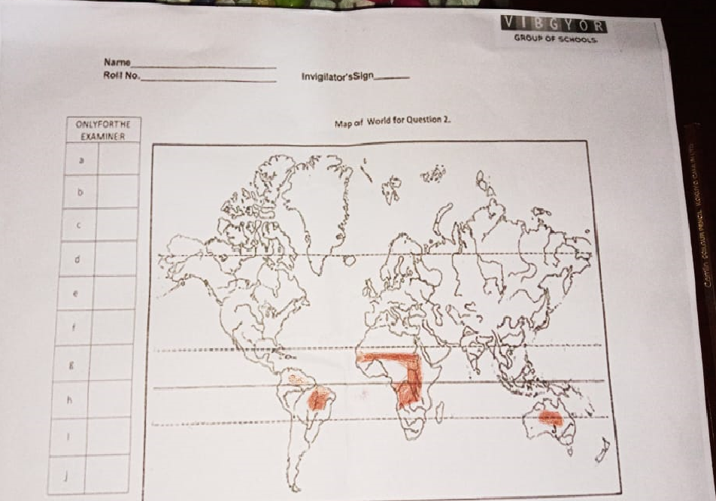
Map Filling

Slide 10
Contribution as a Citizen
we can plant more tree saplings near by and not to use one day vehicle for a week aware our Neighbors friend family, etc. about the pollution and plant more tree saplings.
We can stick and give out posters telling to plant a sapling and not give out more pollution by vehicles. Use cycles to got to nearby places.

Slide 11
Conclusion
The tropical grasslands represent a pivotal place for the emergence of a multi-functional agriculture that responds to the food security–biodiversity–global changes crisis. It covers a very large area of the world’s most biologically productive biome and its human resources remain underutilized. As outlined above, new agro-ecological regimens can further the emergence of a multi-functional agriculture in this setting. These processes necessitate in addition to specific interventions, strategies and coordination among different actors (breeders, policy makers, researchers, etc.) that intervene in various ways, at different levels and at appropriate scales of action to implement consistent management of grasslands.
Researchers can expedite this agro-ecological transition by abandoning the heretofore dominant productivist model of agriculture and adopting an agro-ecological model of agriculture that stresses the multiple direct and indirect contributions of agriculture to societal well-being.

Slide 12
Continued….
This intellectual conversion would incorporate researchers into a societal pact that federates all the stakeholders around an agro-ecological project .It calls for the development of convenient tools and methods to develop radical innovations and more widely to collectively think and organize a transition to a more agro-ecological, multi-functional agriculture. This program is of first importance in vulnerable areas like the Tropics. It should increase their contributions of people in these places to worldwide efforts to cope with the food security—biodiversity—global changes crisis. This agro-ecological transition would also integrate the goals of production and consumption through a continuous dialogue between producers and consumers, which relies on an environmental commitment and ethic. This then necessitates as required by the “Developing Sound Tools for Sustainable Food and Agriculture”.

Slide 13
Bibliography
Google: www.google.com
Byju’s: www.byjus.com
Wikipedia: www.Wikipedia.com
Brainly: www.brainly.in

Slide 14

Acknowledgement
I would like to thank my principal and my teachers to give me such a good opportunity to do this project on Natural Regions of The World where I learned about many new things. This project helped me to make this topic more interesting for me to learn.

Slide 15
Thank You

